Slide 1
Crossing the Data Chasm in Manufacturing:
Preparing your factory for Industrial IoT
Kevin Hartman
For Executive Committee on Operational Technology Integration
Wednesday, May 22, 2019
Notes:
Speaker Name: Kevin
Speaker Notes:
This presentation is prepared for the executive steering committee tasked with integrating the operational technology on the shop floor with the corporate IT systems on the top floor.

Slide 2
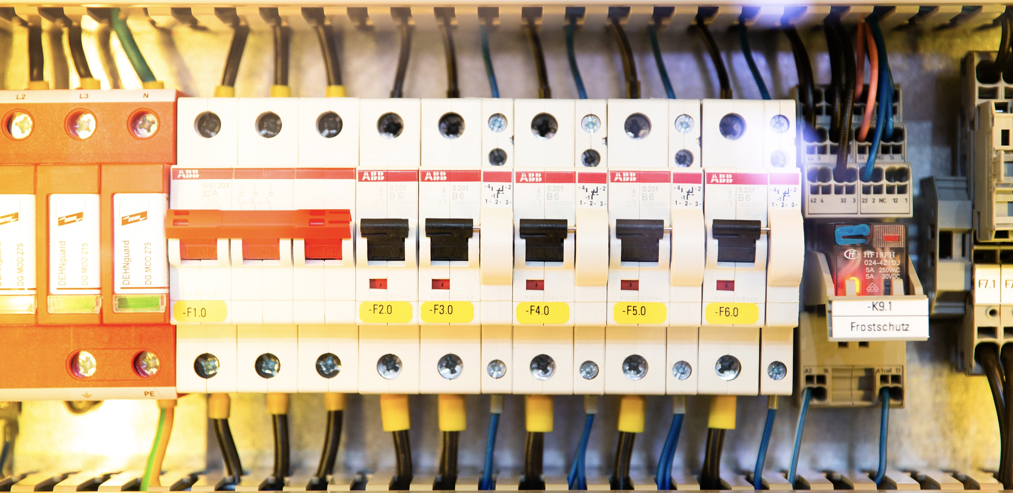
A few key terms...
Operational Technology (OT) - The onboard control systems that are used to monitor and manage realtime factory processes
Industrial IoT (IIoT) - Connecting machine sensors and their data to the internet, and performing analytics on this massive new dataset
PLC - A programmable logic device that interact with machine equipment to provide low level instructions in real time
Notes:
Speaker Name: Kevin
Speaker Notes:
Operational Technology consists of the automation control systems that directly control and monitor the physical machines of the factory floor.
IIoT is what enables the Smart Factory concept.

Slide 3



Technology is Transforming Manufacturing
Key areas driving change
Supply Chain Integration
Predictive Maintenance
Proactive Monitoring
Manufacturing as a Service
Human Augmentation
Computer vision, robotics and automation
Telematics, IoT and autonomous vehicles
Biggest deterrent
What if you have a traditional factory with old machinery?
Notes:
Speaker Name: Kevin
Speaker Notes:
New technology is driving change in manufacturing
Decentralization technologies like blockchain for integrating the supply chain and tracking a company’s processes from raw procurement to distribution
Predictive maintenance and proactive monitoring solutions enabled by integrating with the shop floor and harvesting the collected data
Modular equipment and 3D printing enabling Manufacturing as a Service
AR devices and exoskeletons augmenting human capabilities
Computer vision enabling higher quality assurance
Robotics and automation enabling futuristic concepts like the “lights-out” or unmanned factory
Telematics, IoT and autonomous vehicles for the logistics end of the spectrum
Most of these use cases are dependent upon aggregating, analyzing, and acting on data. It depends on the convergence of OT and IT.
New “greenfield” factories of today are being built where these lines aren’t drawn. They will more easily enable the new and emerging use cases.
But what if you have a traditional factory with old machinery? How do you get access to the data?

Slide 4
Crossing the Data Chasm
Gap in Data Acquisition
Information is trapped
Legacy control equipment designed for different purpose
Protections to safeguard data still evolving
Gap in Data Analysis
Finding the right data
Adapting to changing data
Moving from description to prediction
Notes:
Speaker Name: Kevin
Speaker Notes:
Data Acquisition Gap
Historic automation systems on the shop floor were built as proprietary systems, isolated from the fast, evolving and connected world of IT. We need to unlock these systems and get access to their data.
The “brain” of the industrial machine is in the programmable logic controller (PLC). It manages the control loop of the machine’s automation task.
The sensors and actuators in the machine are capable of generating massive amounts of data - but only a fraction of it is used by the PLC. We need to change, augment or replace the PLC design to access to this comprehensive data.
Success in connecting the networks and accessing data will introduce a new set of challenges. Industrial networks were designed to be isolated and do not have the same level of protections as IT regarding security. The methods to protect and safeguard data is still evolving.
Analysis Gap
In a typical factory, more than 99% of data is discarded without deriving an insight. For most manufacturers, data is a byproduct of production and never reviewed or analyzed. Sorting through the sheer volume of data collected will be an early challenge. (finding the right data)
Integration with other sources is also necessary to inform new insights. The nature of data from the supply chain will vary, it will change rapidly and it will be dynamic. The more dynamic the data, the more difficult it will be to analyze. (adapting to changing data)
A Smart Factory requires collecting, analyzing, transporting, and storing vast amounts of data. The data must be filtered and processed to extract meaning and value. Then it must be analyzed. Not just in a descriptive sense, but in using it to make predictions and to inform us on where to spend resources. (moving from description to prediction)

Slide 5
Building the Bridge to IIoT
Create a Connected Environment
Establish “shop floor to top floor” connectivity
Ingest data from PLCs, equipment, and third party systems
Perform data analysis to build models and insights
Act on insights by automating processes and controls
Notes:
Speaker Name: Kevin
Speaker Notes:
Establish “shop floor to top floor” connectivity by making sensor and actuator data available to IT systems.
equip each sensor and actuator with an active communication module
upgrade or reprogram PLCs to deliver all its data
introduce an aggregator inside the control loop without modifying the PLC
Ingest broad array of data from PLCs, equipment, and other third party systems into a data platform
Analyze data to extract insights that can inform the business and develop predictive models that can proactively identify issues
Act on insight by automating a connected process, optimizing a downstream system, or informing the business

Slide 6
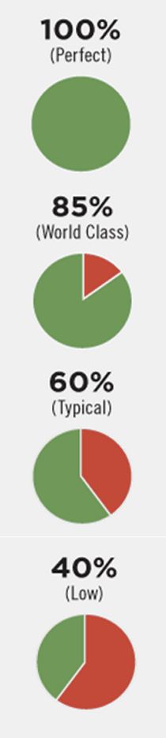

Taking in the Vista
Who will benefit?
Manufacturing Operators
Production Managers
Line Managers
Quality Control
Supply and Delivery Partners
Customers
“According to lean manufacturing metrics (measured by overall equipment effectiveness, or OEE), world class manufacturing sites are working at 85% of their theoretical capacity. Yet the average factory is only at about 60%.” - cbinsights
Notes:
Speaker Name: Kevin
Speaker Notes:
Who?
Myriad of stakeholders throughout the organization
But more specifically the operations leader who wants to:
Improve visibility
Lower cost
Increase performance
Make improvements in reliability and predictability
Have better operational effectiveness
Where’s the opportunity in a competitive sense?
We can look at the OEE measurement - Overall Equipment Effectiveness
85% - Industrial Giants - already have initiatives for using their data
60% - Rest of the world - initiatives not defined or still being thought out

Slide 7
Obstacles and Opportunities
Making the right investment
Sensitivity around cost and budget
Platform selection
OT integration method
Making the investment right
Corporate data strategy
Research methods
Aligning work to outcomes
Notes:
Speaker Name: Kevin
Speaker Notes:
Aligning work to outcomes:
Lower the cost of poor quality (COPQ) and improve equipment efficiencies
Increase the mean time between failures (MTBF) in equipment through predictive maintenance
Predict supply shortages and demand spikes using historical data and Machine Learning

Slide 8
Next Steps
Key Takeaways
Decide on OT integration method
Define the data strategy
Pick a data platform
Implement processes for prep and transformation
Define analysis and research methods
Build out integrations
Deliver intelligence and insights
Notes:
Speaker Name: Kevin
Speaker Notes:
Decide on OT integration method: Direct Connect, PLC Upgrade or Aggregate Gateway
Define data strategy: Do we have the right data?
Pick a data ingestion platform: Connect sources to the pipeline
Implement process for data prep: Transform, cleanse, normalize
Define analysis and research methods: Hypothesis, models and testing
Build out integrations: Detect anomalies, predict failures, integrate with systems
Deliver intelligence: Create dashboards, visualizations, connect it to business strategy

Slide 9
Resources
Future Factory: How Technology is Transforming Manufacturing - CBInsights https://www.cbinsights.com/research/future-factory-manufacturing-tech-trends/
Smart Factory Applications in Discrete Manufacturing - Industrial Internet Consortium
https://www.iiconsortium.org/pdf/Smart_Factory_Applications_in_Discrete_Mfg_white_paper_20170222.pdf
How Supply Chain Systems Integration is a Game Changer - IndustryWeek
https://www.industryweek.com/supply-chain/how-supply-chain-systems-integration-game-changer
Notes:
Speaker Name: Kevin
Speaker Notes:
Resources used in preparation of this presentation

Slide 10
Questions?
Kevin Hartman
kevin.hartman@berkeley.edu
Notes:
Speaker Name: Kevin
Speaker Notes:
Thank you!

